Slide 1
Properties of
Context-Free languages
Costas Busch - LSU

Slide 2



Union
Context-free languages
are closed under:
Union
is context free
is context free
is context-free
Costas Busch - LSU

Slide 3
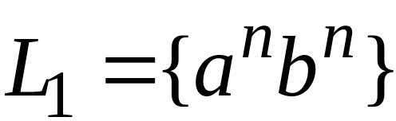
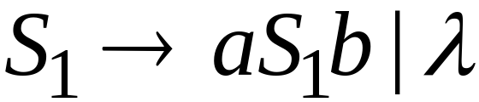
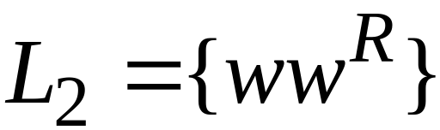
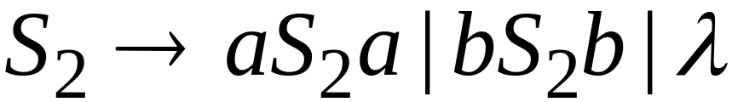
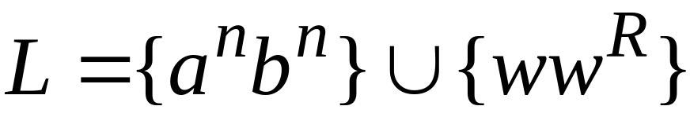

Example
Language
Grammar
Union
Costas Busch - LSU

Slide 4
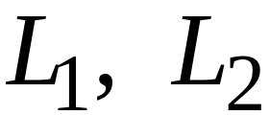
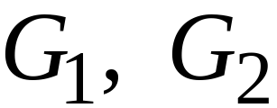
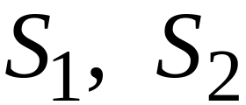

In general:
For context-free languages
with context-free grammars
and start variables
The grammar of the union
has new start variable
and additional production
Costas Busch - LSU

Slide 5

Concatenation
Context-free languages
are closed under:
Concatenation
is context free
is context free
is context-free
Costas Busch - LSU

Slide 6
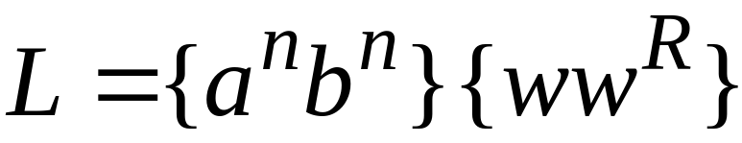
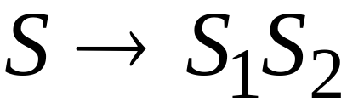
Example
Language
Grammar
Concatenation
Costas Busch - LSU

Slide 7
In general:
For context-free languages
with context-free grammars
and start variables
The grammar of the concatenation
has new start variable
and additional production
Costas Busch - LSU

Slide 8


Star Operation
Context-free languages
are closed under:
Star-operation
is context free
is context-free
Costas Busch - LSU

Slide 9
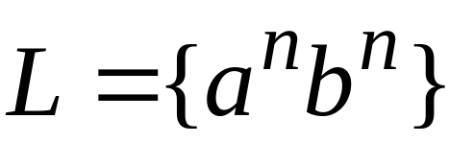
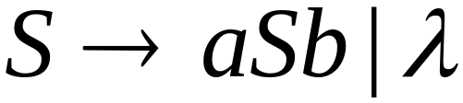
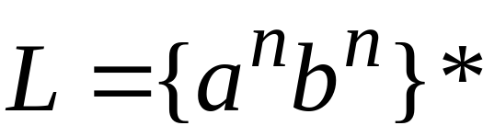
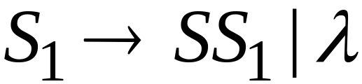
Example
Language
Grammar
Star Operation
Costas Busch - LSU

Slide 10



In general:
For context-free language
with context-free grammar
and start variable
The grammar of the star operation
has new start variable
and additional production
Costas Busch - LSU

Slide 11
Negative Properties of
Context-Free Languages
Costas Busch - LSU

Slide 12

Intersection
Context-free languages
are not closed under:
intersection
is context free
is context free
not necessarily
context-free
Costas Busch - LSU

Slide 13
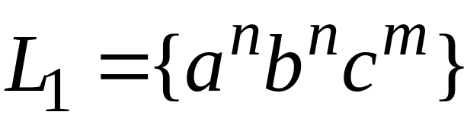
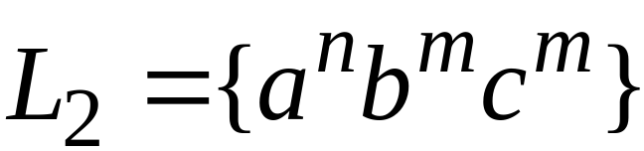
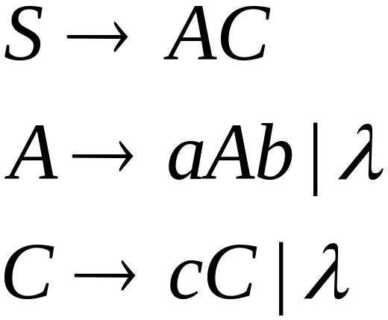
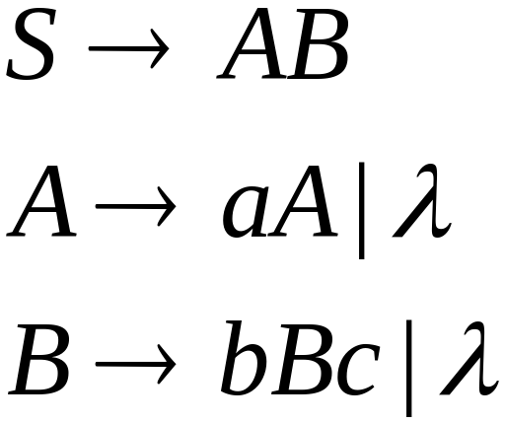
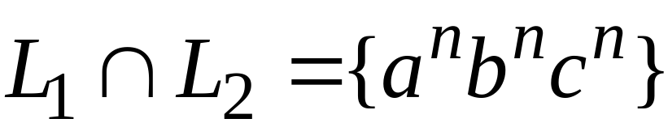
Example
Context-free:
Context-free:
Intersection
NOT context-free
Costas Busch - LSU

Slide 14

Complement
Context-free languages
are not closed under:
complement
is context free
not necessarily
context-free
Costas Busch - LSU

Slide 15
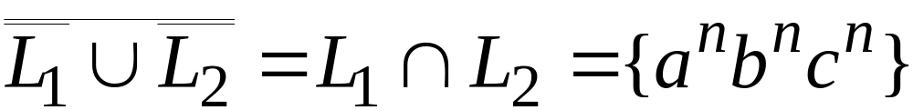
Example
Context-free:
Context-free:
Complement
NOT context-free
Costas Busch - LSU

Slide 16
Intersection of
Context-free languages and
Regular Languages
Costas Busch - LSU

Slide 17
The intersection of
a context-free language and
a regular language
is a context-free language
context free
regular
context-free
Costas Busch - LSU

Slide 18



Machine
Machine
NPDA
for
DFA
for
context-free
regular
Construct a new NPDA machine
that accepts
simulates in parallel and
Costas Busch - LSU

Slide 19
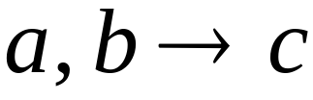




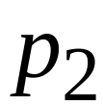
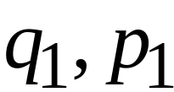
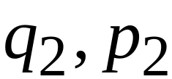
NPDA
DFA
transition
transition
NPDA
transition
Costas Busch - LSU

Slide 20


NPDA
DFA
transition
NPDA
transition
Costas Busch - LSU

Slide 21


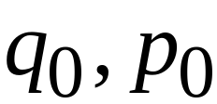
NPDA
DFA
initial state
initial state
NPDA
Initial state
Costas Busch - LSU

Slide 22
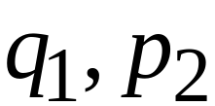
NPDA
DFA
final state
final states
NPDA
final states
Costas Busch - LSU

Slide 23
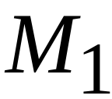









Example:
context-free
NPDA
Costas Busch - LSU

Slide 24
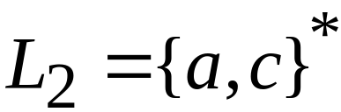
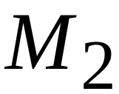


regular
DFA
Costas Busch - LSU

Slide 25
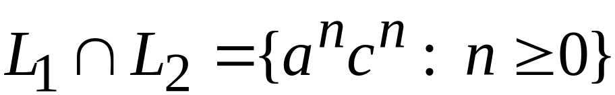





context-free
Automaton for:
NPDA
Costas Busch - LSU

Slide 26


In General:
simulates in parallel and
accepts string
if and only if
accepts string and
accepts string
Costas Busch - LSU

Slide 27
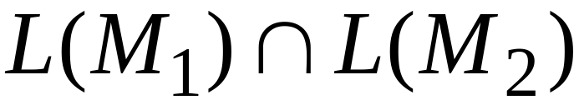
Therefore:
is NPDA
is context-free
is context-free
Costas Busch - LSU

Slide 28
Applications of
Regular Closure
Costas Busch - LSU

Slide 29
The intersection of
a context-free language and
a regular language
is a context-free language
Regular Closure
context free
regular
context-free
Costas Busch - LSU

Slide 30
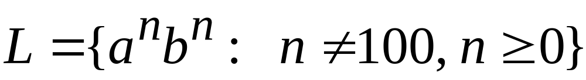
An Application of Regular Closure
Prove that:
is context-free
Costas Busch - LSU

Slide 31

We know:
is context-free
Costas Busch - LSU

Slide 32
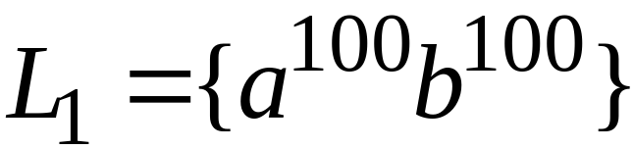
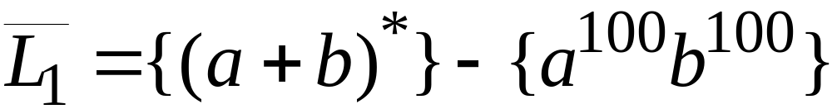
We also know:
is regular
is regular
Costas Busch - LSU

Slide 33
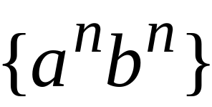
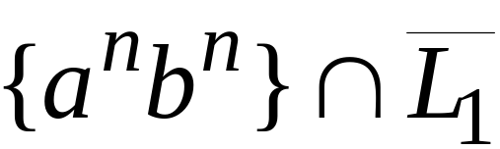
context-free
regular
(regular closure)
context-free
is context-free
Costas Busch - LSU

Slide 34
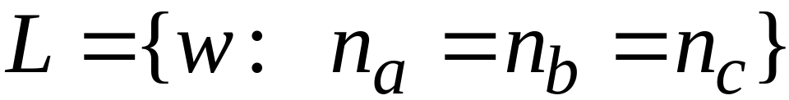
Another Application of Regular Closure
Prove that:
is not context-free
Costas Busch - LSU

Slide 35
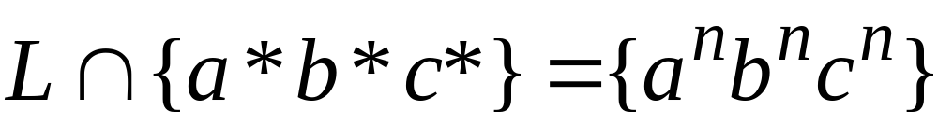
If
is context-free
(regular closure)
Then
context-free
regular
context-free
Impossible!!!
Therefore, is not context free
Costas Busch - LSU

